Slide 1

COMMUNICATIONS DEPARTMENT: Ground station
Boyan Naydenov, Josep Puig, Josep Maria Serra, Sergi Tarroc and Eva María Urbano

Slide 2
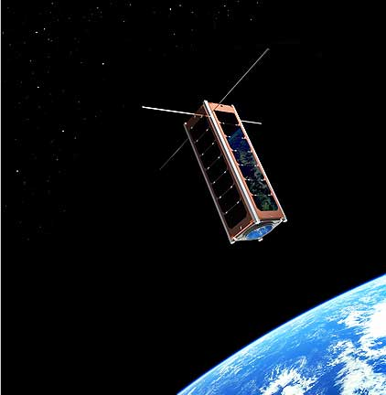

What are we going to talk about?
Work done:
Critical failure
Ground station
Location
Cost

Slide 3
Critical failure
Project charter deffinition
A major failure can be defined as the loss of a client’s satellite coverage because of a failure in the network.
New deffinition
A failure in the network that causes a message to arrive from a client satellite to a ground station with more that 5 minutes of delay, or not arrive at all.

Slide 4
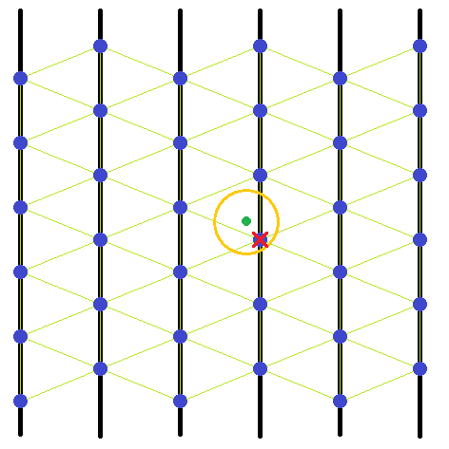
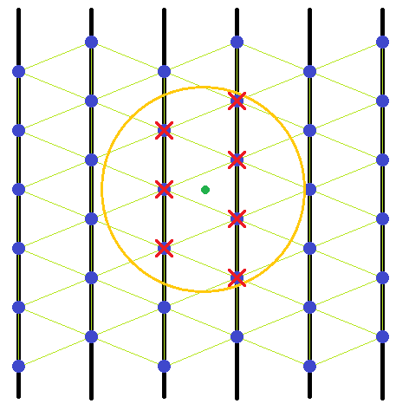
Critical failure: Coverage failure
Satellites in range of the client’s satellite: depends of the client’s satellite
Critical failure: failure of all satellites in range of the client’s satellite

Slide 5
Critical failure: Transmission time failure
Transmission time ≈ 0,5 s
Processing time ≈ 20 s
Time to recognise a link as dead ≈ 45 s
Time to reconfigure the network map ≈ 100 s
Total time ≈ 165 s
Time limit = 300 s
Time to reconfigure 2 successive failures ≈ 310 s
Critical failure: failure of two satellites in the same communication route consecutively

Slide 6
Critical failure: Ground station failure
If all ground stations fail, the whole constellation fails.
Each ground stations is considered critical
Critical faiure: loss of satellite visibility for any ground station

Slide 7
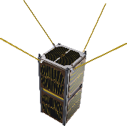




Ground segment structure
Mission Control Centre
Only one
Located in Terrassa
Handles all the data
Checks the constellation status
Gives instructions to the satellites in case of need
Ground Station
More than one
Located across the globe
Recieves TT&C and HK data and sends it to the Mission Control Centre
Recieves data from the client satellite and sends it to the client
Ground Station
S-Band
X-Band
MCC

Slide 8
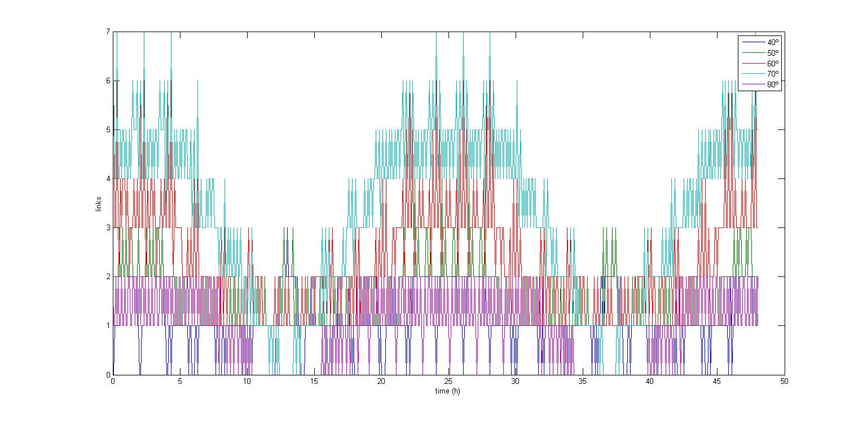
Ground Station: location
Coverage in different latitudes over time

Slide 9
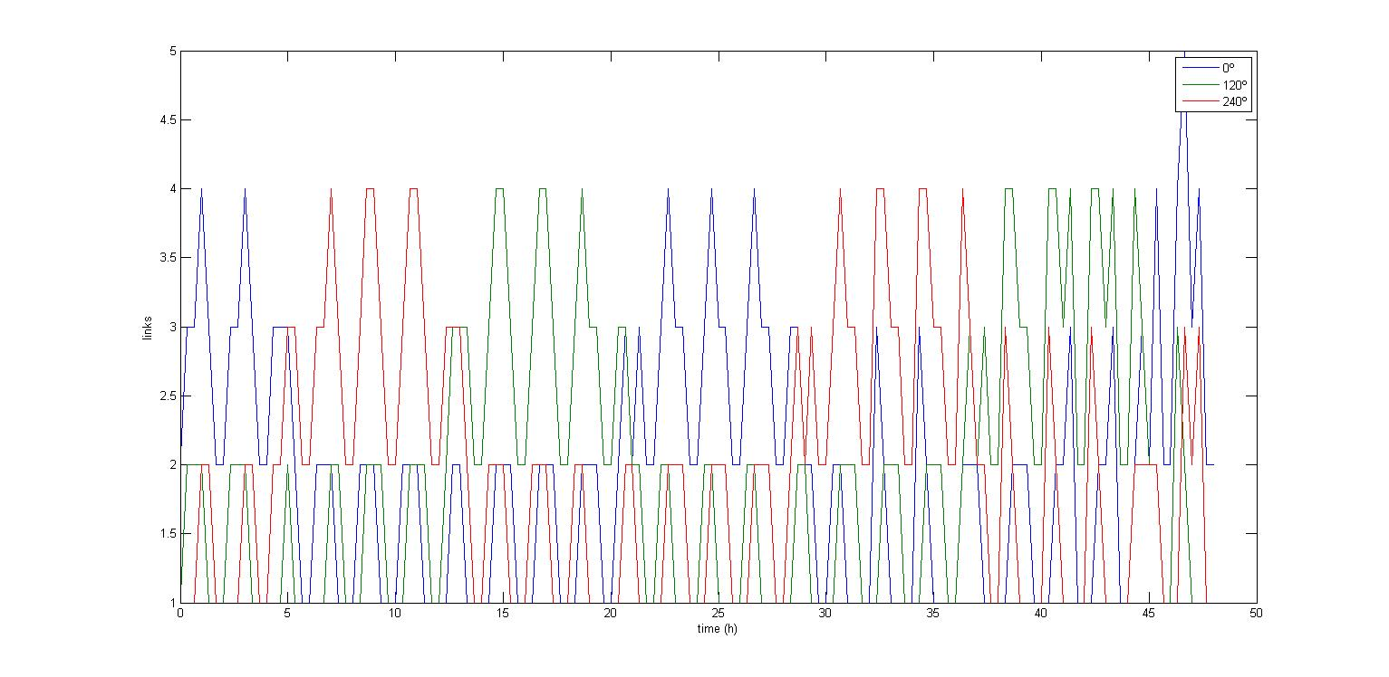
Ground Station: location
Coverage in different longitudes over time

Slide 10
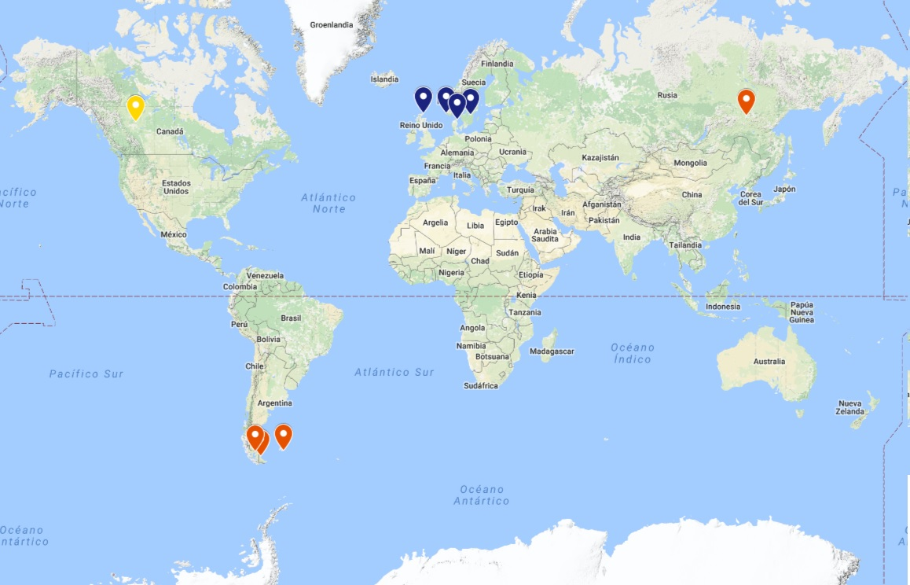
Ground Station: location
Possible optimum Ground Station locations
Final location:
Ground Station 1:
Canada
Ground Station 2:
Scotland
Ground Station 3:
Falkland Islands

Slide 11
Ground Station: costs
Each Ground Station will consist of:
100 m² building
Communication equipment
Office equipment
Electricity
Water
Internet connection
Ground Station license
Workers

Slide 12
Ground Station: costs
Two systems: X-band and S-band

Slide 13
Ground Station: costs
Costs | Canada | Scotland | Falkland Islands
Electricity | 3,500 € | 6,500 € | 6,500 €
Maintenance | 7,500 € | 7,500 € | 7,500 €
License fee | 200 € | 600 € | 600 €
Salaries | 380,000 € | 295,000 € | 125,000 €
Total | 390,000 € | 310,000 € | 140,000 €
Total annual cost of all Ground Stations: 840,000 €

Slide 14
Mission Control Centre: costs
The Mission Control Centre will consist of:
500 m² building
Office equipment
Electricity
Water
Internet connection
Workers

Slide 15
Mission Control Centre: costs
 | Costs
Electricity | 15,000 €
Maintenance | 7,500 €
Salaries | 375,000 €
Total | 400,000 €
Total annual cost of the Mission Control Centre: 400,000 €
Total annual cost of all Ground Stations and the Mission Control Centre: 1,240,000 €

Slide 16
Summary
Critical failure
Clear deffinition of a critical failure
Ground segment
Ground Stations located in Canada, Scotland and Falkland Islands
Annual cost of all Ground Stations:840,000 €
Annual cost of the Mission Control Centre: 400,000 €

